Slide 1

Apache Mahout
Big Data Lab
8th October 2025

Slide 2
Mahout Collab Setup
Upload Provided Collab Notebook (Apache_Mahout.ipynb)
Run first cell and upload provided mahout .tar file
Once First cell runs completely and once shell command line comes at last stop the cell
Start second shell to launch Scala Shell
If it does not work run Third cell and try again

Slide 3
What is Apache Mahout ?
An open-source project from the Apache Software Foundation.
Its primary goal is to provide a framework for executing ML algorithms on large datasets.
Designed to build scalable machine learning (ML) applications
Why Use Mahout?
Scalability: Built to run on large clusters, handling datasets that are too big for a single machine.
Pre-built Algorithms: Provides a library of implemented and tested machine learning algorithms.
Open Source: Free to use, modify, and distribute. Backed by a strong community.

Slide 4
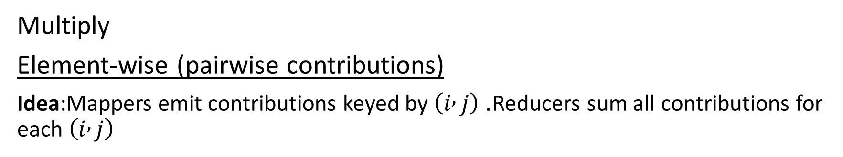
Problem setup
Multiply
Element-wise (pairwise contributions)
Idea:Mappers emit contributions keyed by $\left(i , j\right)$. Reducers sum all contributions for each $\left(i , j\right)$
Mapper (concept)
Input: elements of A or B as tuples: (A, i, k, value) or (B, k, j, value)
For an A-element (i,k,valA) produce for all j in [0..p-1]:
  emit key (i,j) value ('A', k, valA)
For a B-element (k,j,valB) produce for all i in [0..m-1]:
  emit key (i,j) value ('B', k, valB)
Reducer (concept)
Input: key (i,j) and list of ('A',k,valA) and ('B',k,valB) values
Build maps Amap[k]=valA and Bmap[k]=valB
Sum over k: sum += Amap[k] * Bmap[k]
Output (i,j,sum)

Slide 5
Basic Mahout Command
Vector Creation | val v = dense(1,2,3) | Create a dense vector
 | val sv = new RandomAccessSparseVector(5) sv.set(0, 10.0) | Create Sparse Vector
Matrix Creation | val m = dense((1,2,3),(4,5,6)) | Create a 2×3 dense matrix
 | val randM = Matrices.symmetricUniformView(3, 3, 12) | Random 3×3 matrix (random seed = 12)
 | val zerosM = new DenseMatrix(3, 3) | All-zero matrix
 | val eyeM = eye(3) | 3×3 identity matrix
Arithmetic (Vectors) | v + v | Add vectors
 | v - v | Subtract vectors
 | v * v | Elementwise multiply
 | v / v | Elementwise divide
 | v.norm | L2 norm
Linear Algebra (Local) | det(m) | Determinant (for square matrices)
 | m.t | Transpose
 | v cross v | Outer product

Slide 6
Basic Mahout Command
Arithmetic (Matrices) | m + m | Matrix addition
 | m - m | Subtraction
 | m * 2.0 | Scalar multiply
 | m / 3.0 | Scalar divide
 | m.t | Transpose
 | m.t %*% m | Matrix multiplication
 | m * v | Matrix × vector
 | val X = solve(A, B) | Solves: A × X = B for unknown X
Decompositions | val svd = svd(m) | Singular Value Decomposition
 | svd.U, svd.S, svd.V | SVD components
 | val eig = eig(m %*% m.t) | Eigen decomposition
 | eig.D, eig.V | Eigenvalues and Eigenvectors
Distributed Matrices (Spark) | val drmA = drmParallelize(m = m)(sdc) | Create distributed matrix from local matrix
 | val drmB = drmA.t %*% drmA | Distributed matrix multiplication
 | val localA = drmA.collect | Bring distributed matrix back to driver

Slide 7
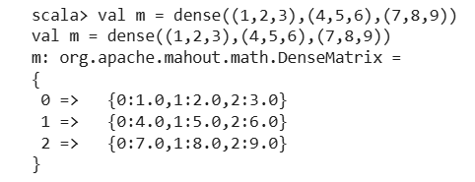
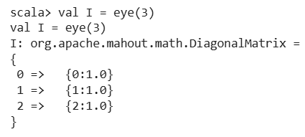
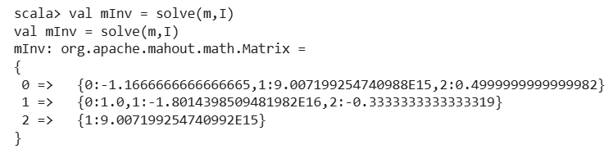
Finding Inverse of Matrix
Defining Matrix Variable
Defining Identity Matrix Variable
Using Solve command to find Inverse

Slide 8

Linear Regression Using Matrix Algebra (Mahout)
We are fitting a linear model:
y=b₀+b₁x₁+b₂x₂
where:
x₁, x₂ ​ = independent variables (features)
y = dependent variable (target/output)
b₀ = intercept (constant term)
b₁, b₂= coefficients (weights)
X (Feature Matrix)
Each row corresponds to one data point.
Each column corresponds to a feature.
The first column is all 1s to account for the intercept term b0​.
y (Target Vector)
Column vector containing the output values for each data point.
Compute β (Coefficients Vector)
The formula for linear regression coefficients using the normal equation:

Slide 9

Lab Task 1
Find Best Fit linear regression line using Matrix Method (Find b₀, b₁, b₂ for equation Y= b₀ + b₁x₁+ b₂x₂ using formula given in previous slide)
X1 | X2 | Y
1 | 2 | 5
2 | 3 | 8
3 | 4 | 11
X =
1 | 1 | 2
1 | 2 | 3
1 | 3 | 4
Y =
5
8
11
$β$ =
b₀
b₁
b₂

Slide 10
Lab Task 2
Find Best Fit Quadratic regression line using Matrix Method (Find b₀, b₁, b₂ for equation Y= b₀ + b₁x+ b₂x² )
X | Y
1 | 2
2 | 5
3 | 10
4 | 17
5 | 27

